Slide 1
Basic NLP

Slide 2
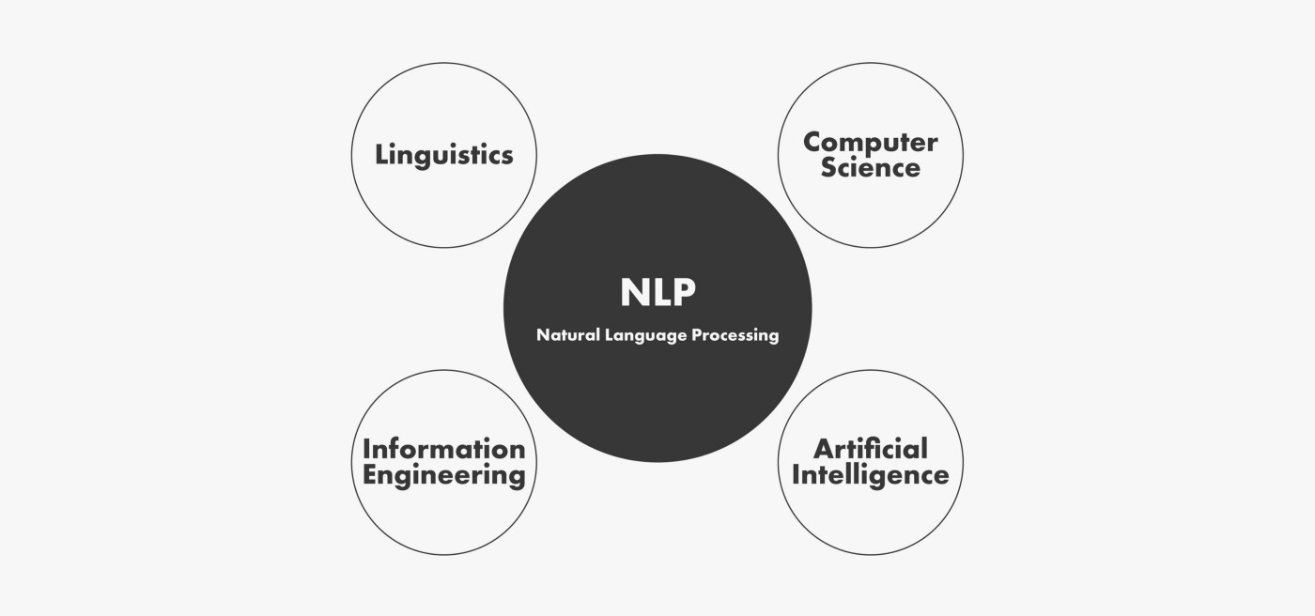
Introduction To NLP
Natural language processing is a subfield of linguistics, computer science, and artificial intelligence concerned with the interactions between computers and human language, in particular how to program computers to process and analyze large amounts of natural language data.
Wikipedia

Slide 3

Why NLP Useful?
NLP enables computers to understand natural language as humans do. Whether the language is spoken or written, natural language processing uses artificial intelligence to take real-world input, process it, and make sense of it in a way a computer can understand.

Slide 4
NLP in the Real World/Core applications:
Email platforms, such as Gmail, Outlook, etc., use NLP extensively to provide a range of product features, such as spam classification, priority inbox, calendar event extraction, auto-complete, etc.
Voice-based assistants, such as Apple Siri, Google Assistant, Microsoft Cortana, and Amazon Alexa rely on a range of NLP techniques to interact with the user, understand user commands, and respond accordingly.
Modern search engines, such as Google and Bing, which are the cornerstone of today’s internet, use NLP heavily for various subtasks, such as query understanding, query expansion, question answering, information retrieval, and ranking and grouping of the results so on.
Machine translation services, such as Google Translate, Bing Microsoft Translator, and Amazon Translate are increasingly used in today’s world to solve a wide range of scenarios and business use cases.
Chatbots

Slide 5
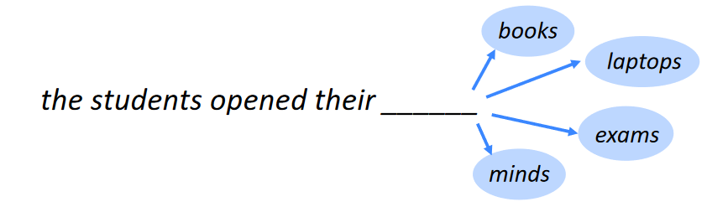
Various NLP Tasks
Language modeling
This is the task of predicting what the next word in a sentence will be based on the history of previous words. The goal of this task is to learn the probability of a sequence of words appearing in a given language. Language modeling is useful for building solutions for a wide variety of problems, such as speech recognition, optical character recognition, handwriting recognition, machine translation, and spelling correction.

Slide 6
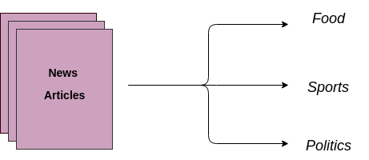
Text classification
This is the task of bucketing the text into a known set of categories based on its content. Text classification is by far the most popular task in NLP and is used in a variety of tools, from email spam identification to sentiment analysis.

Slide 7
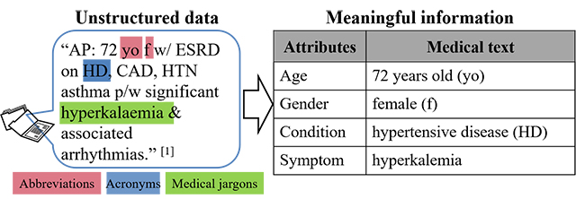
Information extraction
As the name indicates, this is the task of extracting relevant information from text, such as calendar events from emails or the names of people mentioned in a social media post.

Slide 8
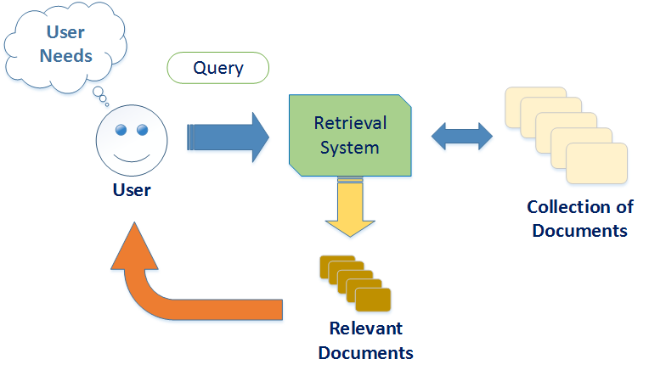
Information retrieval
This is the task of finding documents relevant to a user query from a large collection. Applications like Google Search are well-known use cases of information retrieval.

Slide 9

Conversational agent
This is the task of building dialogue systems that can converse in human languages. Alexa, Siri, etc., are some common applications of this task.

Slide 10
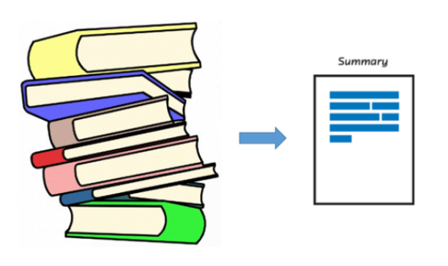
Text summarization
This task aims to create short summaries of longer documents while retaining the core content and preserving the overall meaning of the text.

Slide 11
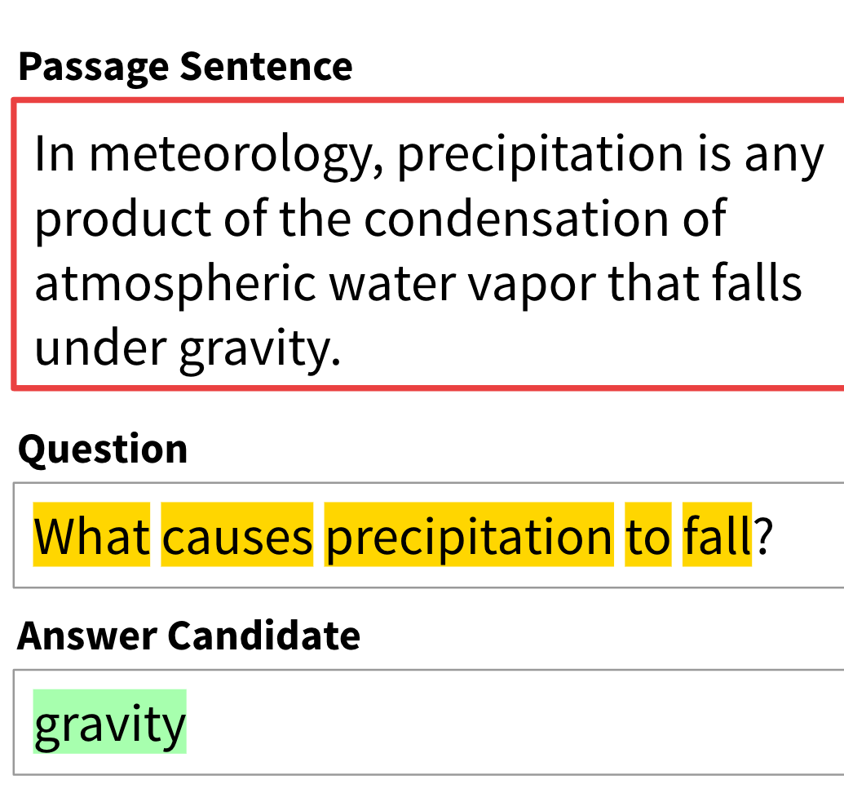
Question answering
This is the task of building a system that can automatically answer questions posed in natural language.

Slide 12

Machine translation
This is the task of converting a piece of text from one language to another. Tools like Google Translate are common applications of this task.

Slide 13
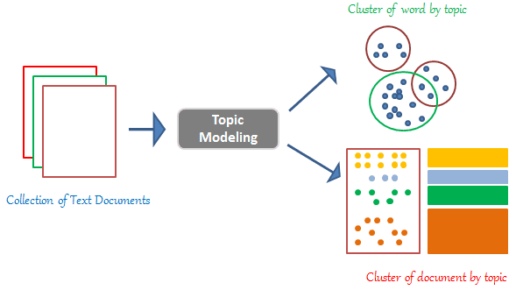
Topic modeling
This is the task of uncovering the topical structure of a large collection of documents. Topic modeling is a common text-mining tool and is used in a wide range of domains, from literature to bioinformatics.

Slide 14
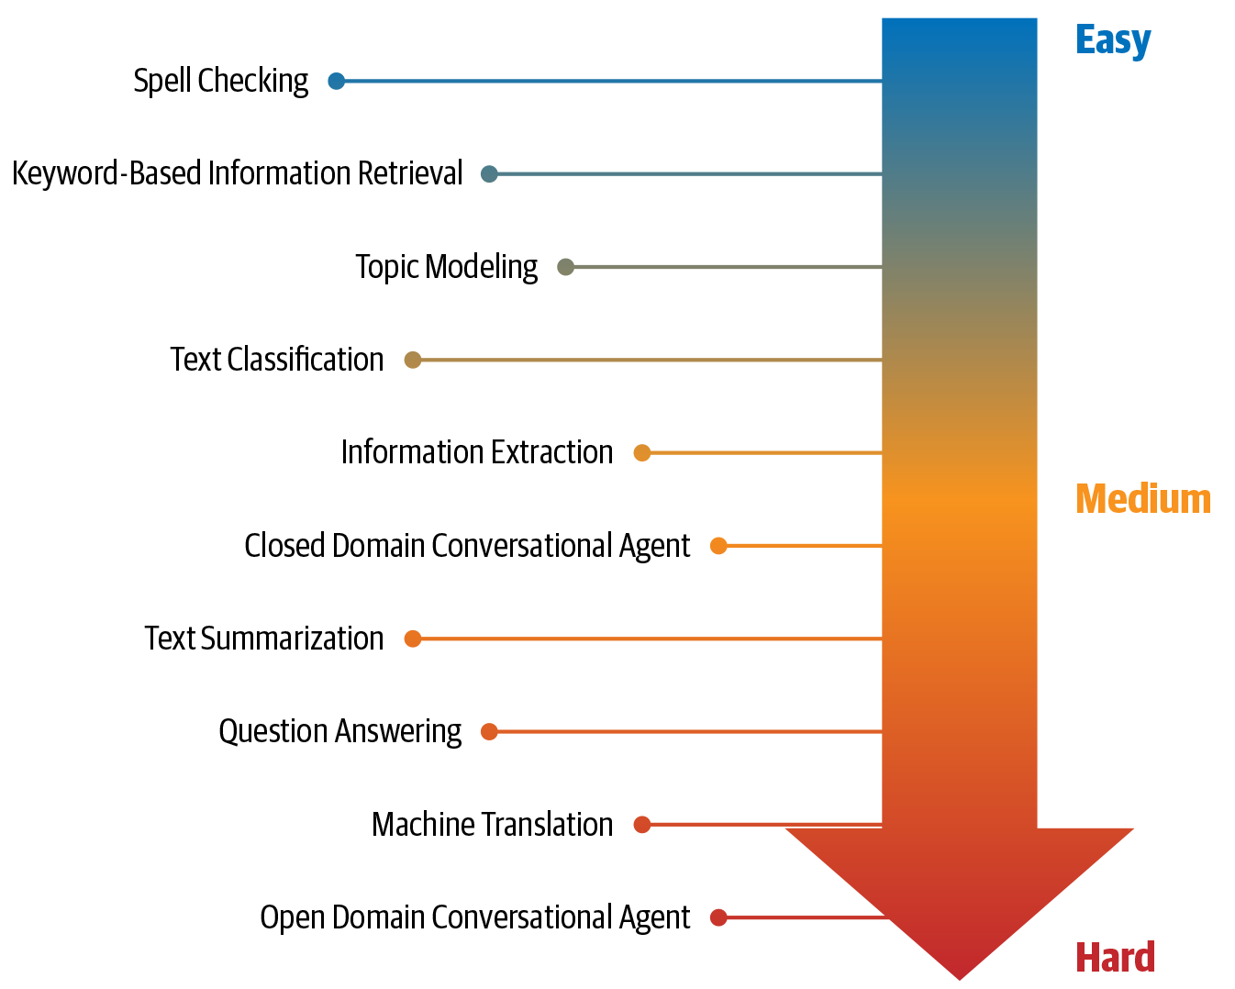
Difficulty in terms of developing comprehensive solutions.

Slide 15
What Is Language?
Language is a structured system of communication that involves complex combinations of its constituent components, such as characters, words, sentences, etc.
We can think of human language as composed of four major building blocks: phonemes, morphemes and lexemes, syntax, and context.

Slide 16
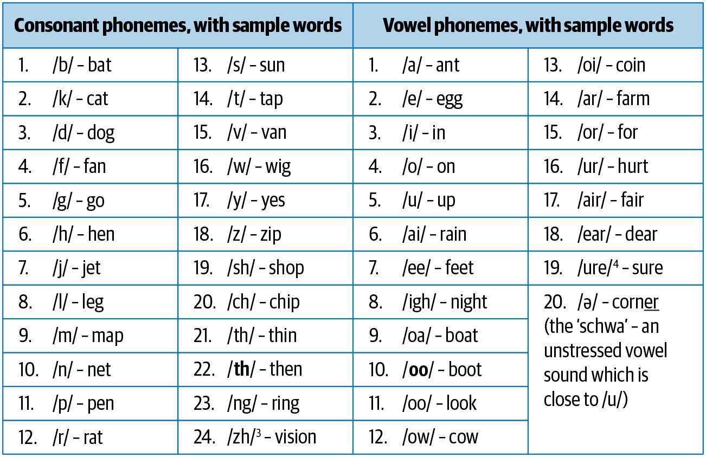
Building Blocks of Language
Phonemes
Phonemes are the smallest units of sound in a language. They may not have any meaning by themselves but can induce meanings when uttered in combination with other phonemes.

Slide 17
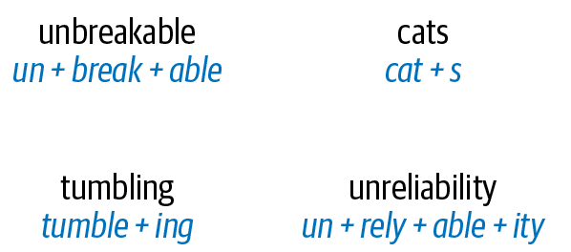
Morphemes and lexemes
A morpheme is the smallest unit of language that has a meaning. It is formed by a combination of phonemes. Not all morphemes are words, but all prefixes and suffixes are morphemes.

Slide 18
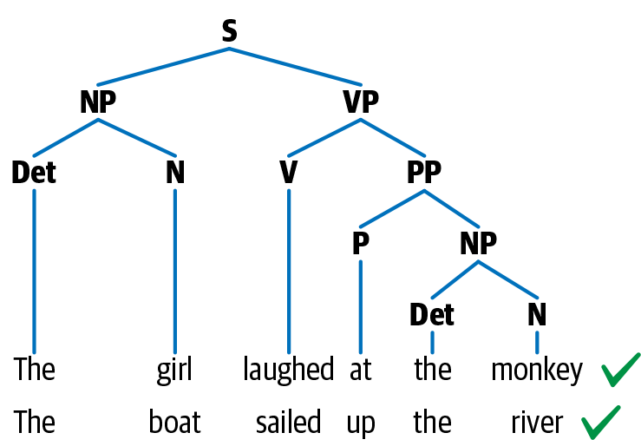
Syntax
Syntax is a set of rules to construct grammatically correct sentences out of words and phrases in a language. Syntactic structure in linguistics is represented in many different ways. A common approach to representing sentences is a parse tree. In this representation, N stands for noun, V for verb, and P for preposition. Noun phrase is denoted by NP and verb phrase by VP.

Slide 19
Context
Context is how various parts in a language come together to convey a particular meaning. Context includes long-term references, world knowledge, and common sense along with the literal meaning of words and phrases.
Complex NLP tasks such as sarcasm detection, summarization, and topic modeling are some of tasks that use context heavily.

Slide 20
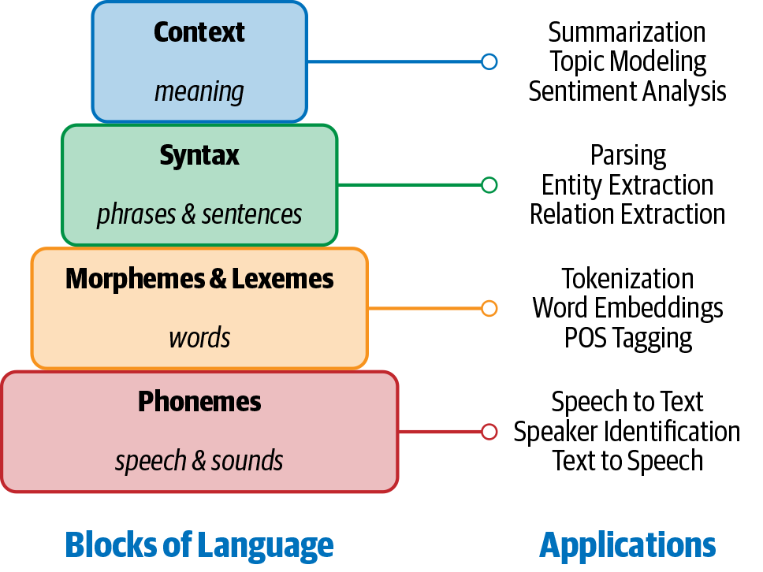
Building blocks of language and their applications

Slide 21
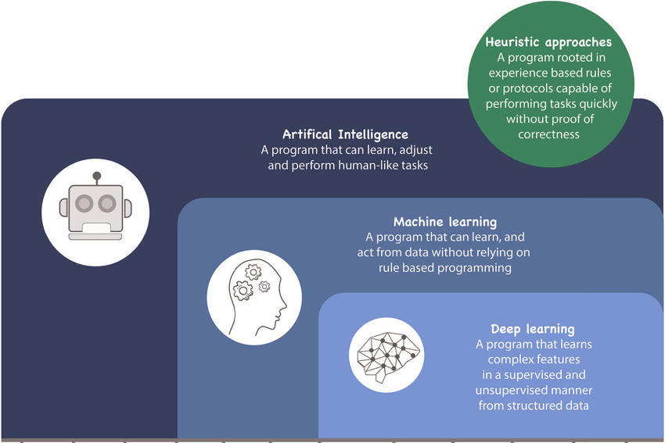
Approaches to NLP
The different approaches used to solve NLP problems commonly fall into three categories: heuristics, machine learning, and deep learning.

Slide 22
Heuristics-Based NLP
Similar to other early AI systems, early attempts at designing NLP systems were based on building rules for the task at hand.
Examples:
Regular Expression
Wordnet
Open Mind Common Sense

Slide 23
Machine Learning for NLP
Machine learning techniques are applied to textual data just as they’re used on other forms of data, such as images, speech, and structured data. Supervised machine learning techniques such as classification and regression methods are heavily used for various NLP tasks.
Naive Bayes
Support vector machine
Hidden Markov Model

Slide 24
Deep Learning for NLP
Huge surge in using neural networks to deal with complex, unstructured data. Language is inherently complex and unstructured. herefore, we need models with better representation and learning capability to understand and solve language tasks. Here are a few popular deep neural network architectures that have become the status quo in NLP.
Recurrent neural networks (RNN)
Long short-term memory (LSTM)
Convolutional neural networks (CNN)
Transformers
Autoencoders

Slide 25
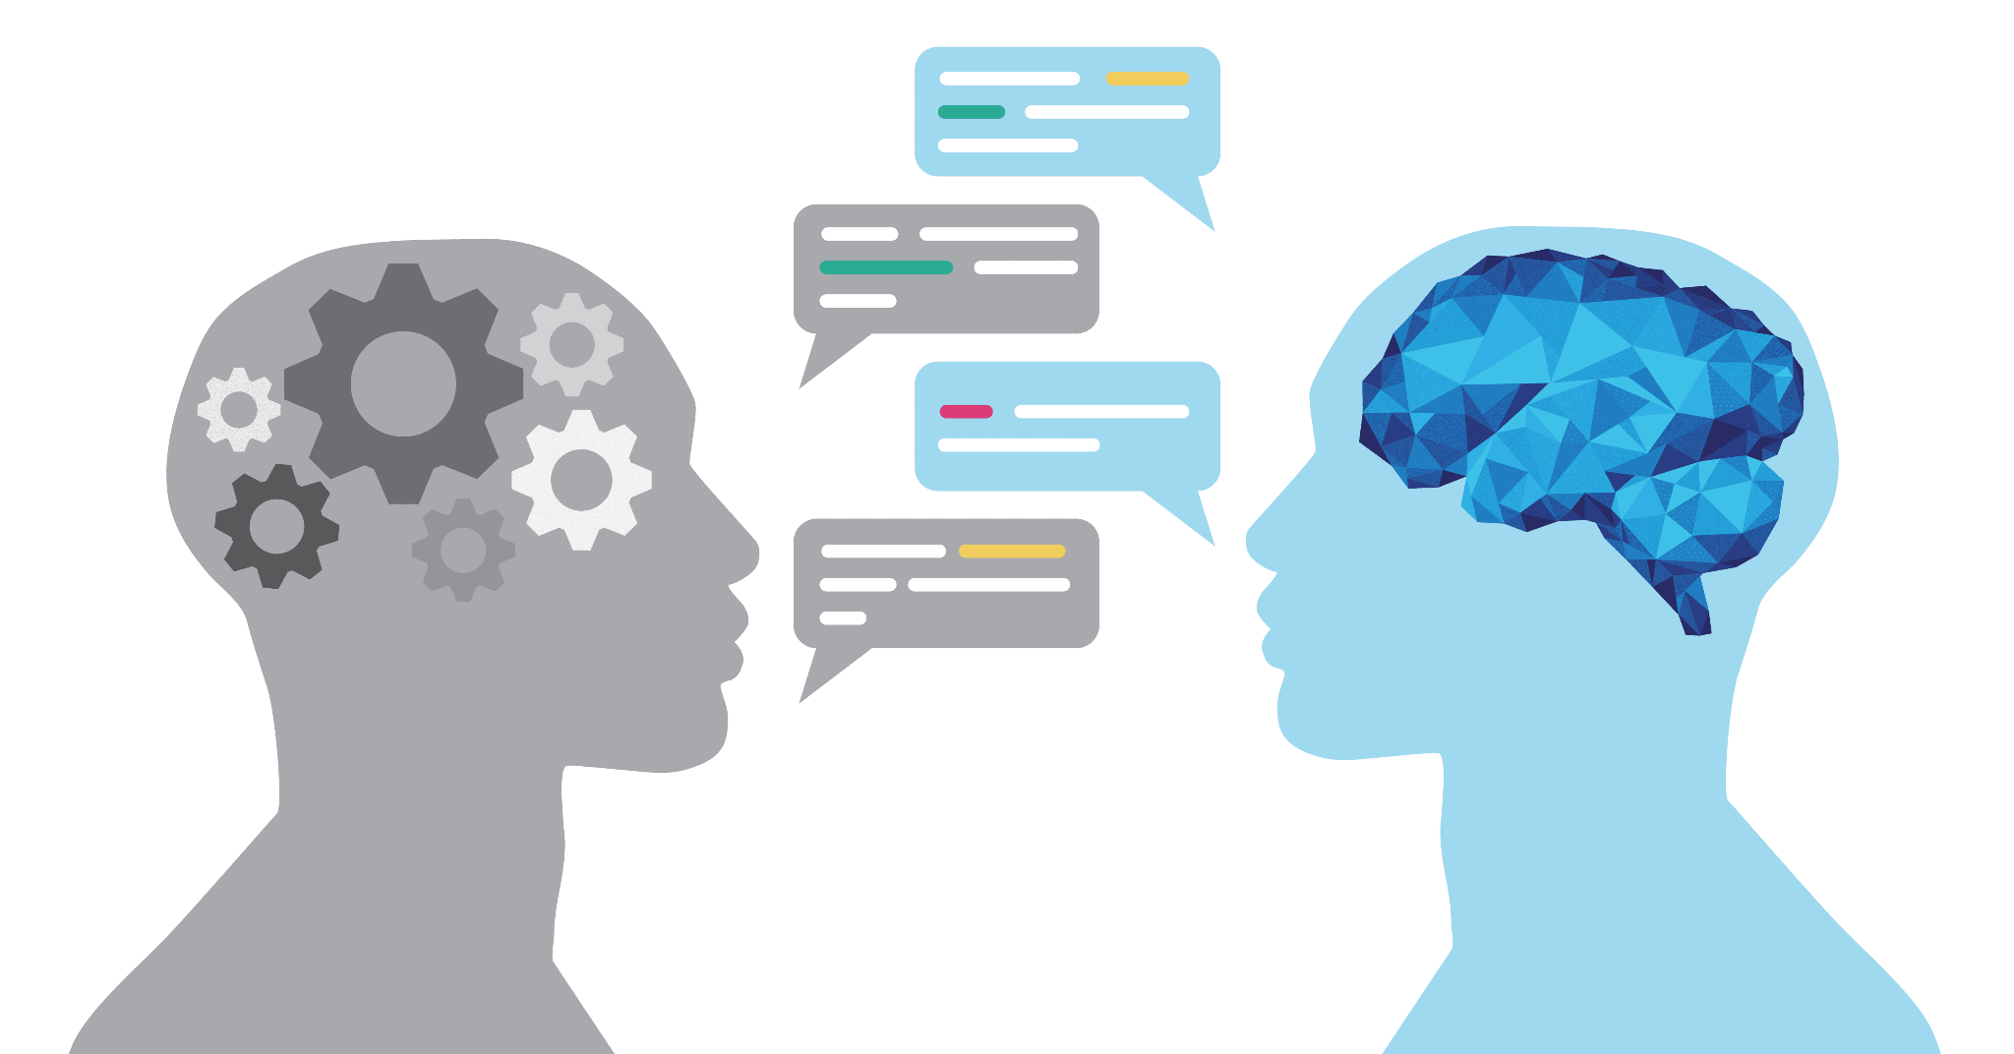
Why Is NLP Challenging?
The ambiguity and creativity of human language are just two of the characteristics that make NLP a demanding area to work in.

Slide 26
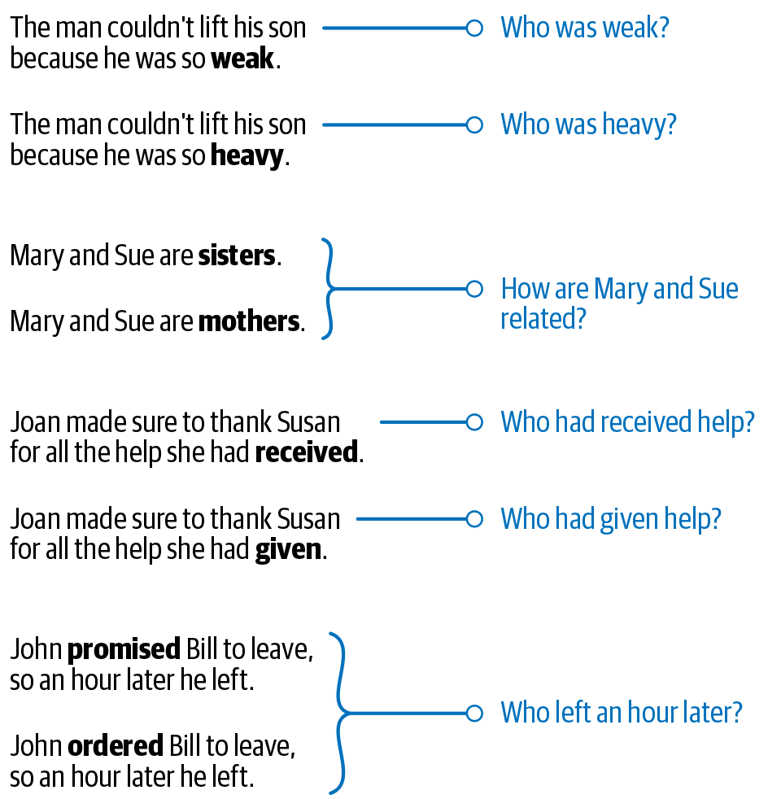
Ambiguity
Ambiguity means uncertainty of meaning!

Slide 27
Common knowledge
A key aspect of any human language is “common knowledge.” It is the set of all facts that most humans are aware of.
Example:
consider two sentences: “man bit dog” and “dog bit man.”

Slide 28
Creativity
Language is not just rule driven; there is also a creative aspect to it. Various styles, dialects, genres, and variations are used in any language. Poems are a great example of creativity in language. Making machines understand creativity is a hard problem not just in NLP, but in AI in general.
& Diversity: There are many languages

Slide 29
Wrapping Up
Introduction To NLP
Why NLP Useful?
NLP in the Real World/Core applications:
Various NLP Tasks
Difficulty in terms of developing comprehensive solutions.
What Is Language?
Building Blocks of Language
Approaches to NLP
Why Is NLP Challenging?

Slide 30


Slide 31
End-to-end NLP Pipeline

Slide 32
What is NLP Pipeline?
Break the problem down into several sub-problems, then try to develop a step-by-step procedure to solve them. Since language processing is involved, we would also list all the forms of text processing needed at each step. This step-by-step processing of text is known as a pipeline.
Data acquisition
Text Preparation
Text Cleanup
Basic Preprocessing
Advance Preprocessing
Feature engineering
Modeling
Evaluation
Deployment
Monitoring and model updating

Slide 33

Points to Remember
It's not universal
Deep Learning pipelines are slightly different
Pipeline is non-linear

Slide 34
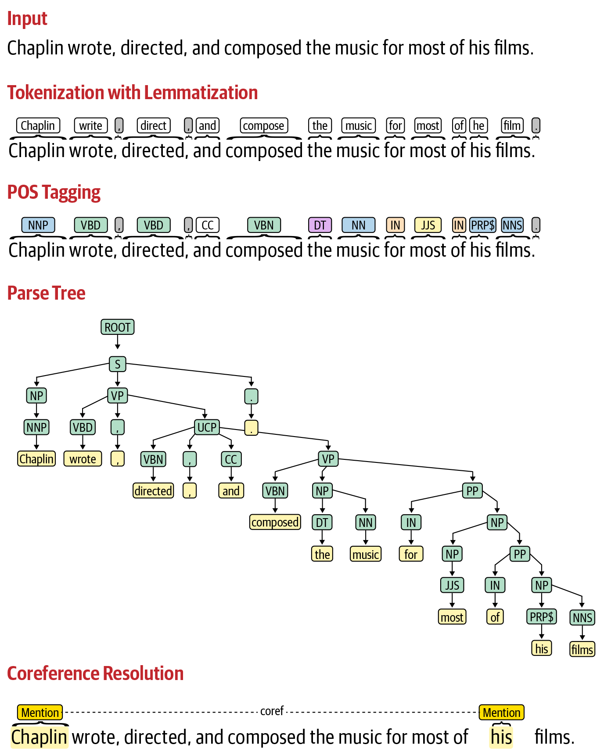

Slide 35

Lets get Hands on

Slide 36


Slide 37
Some Resources to Follow
Books:
Practical natural language processing
Natural language processing with transformers

